Slide 1

Basic Electrical and Electronics Engineering (Tutorials)
Mr. K. Sateesh Kumar
Assistant Professor
Electrical and Electronics Engineering
SRMIST, Kattankulathur-603203

Slide 2
Contents:
Introduction to AC and its representation
Sinusoidal Voltage
Average Value
RMS Value
Form Factor and Peak Factor
Power and Power Factor
Resistance Connected to Sinusoidal Source
Inductance Connected to Sinusoidal Source
Capacitance Connected to Sinusoidal Source
Impedance, Conductance, Susceptance and Admittance
Solved Problems

Slide 3
Tutorial - 09
Alternating current (AC) Fundamentals
Introduction
Periodic waveform
Important Terminology
Values of Alternating voltage and current

Slide 4
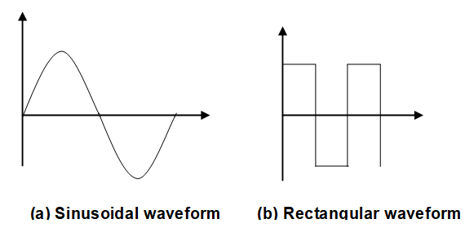
Three major advantages of AC:
Can step-up or down efficiently by means of a transformer.
A.C motors are cheaper and simpler in construction
Control of switch gear (switches, circuit breakers etc) for AC system is simpler than the DC system.
Statement:
A voltage which changes its polarity at regular intervals of time is called an alternating voltage.
V(t)
t

Slide 5
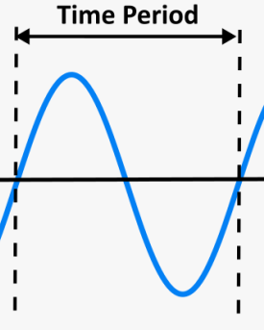
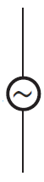

The sources in which the current/voltage sinusoidally varies with time are called sinusoidal sources.
The sinusoidal sources undergoes cyclic changes and the number of cycles per second is called frequency ( f ). The unit of frequency is Hertz (Hz).
The time for one cycle is called time period. (T=1/f)
Since the sinusoidal voltage/current has alternate identical positive and negative half cycles, it is called alternating voltage/current or in short AC sources.
p
V
n

Slide 6
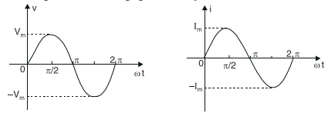
Vm , Im are the amplitude of the sinusoid
ω is the angular frequency in radians/sec = 2*pi*f
ωt argument of the sinusoid

Slide 7
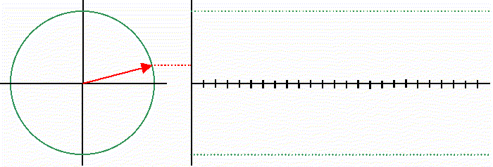
Phasor
Sinusoidal quantities are rotating vectors.
The plot of the instantaneous value on an angular scale or time scale gives the waveform of a sinusoidal quantity.
Rotating vectors are functions of phase angle and so they are called phasors
The phase angle of a vector is the angular position of the vector with respect to reference at time t = 0.

Slide 8
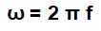
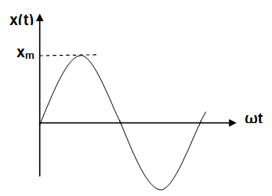
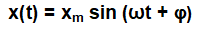
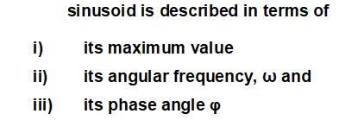

Slide 9
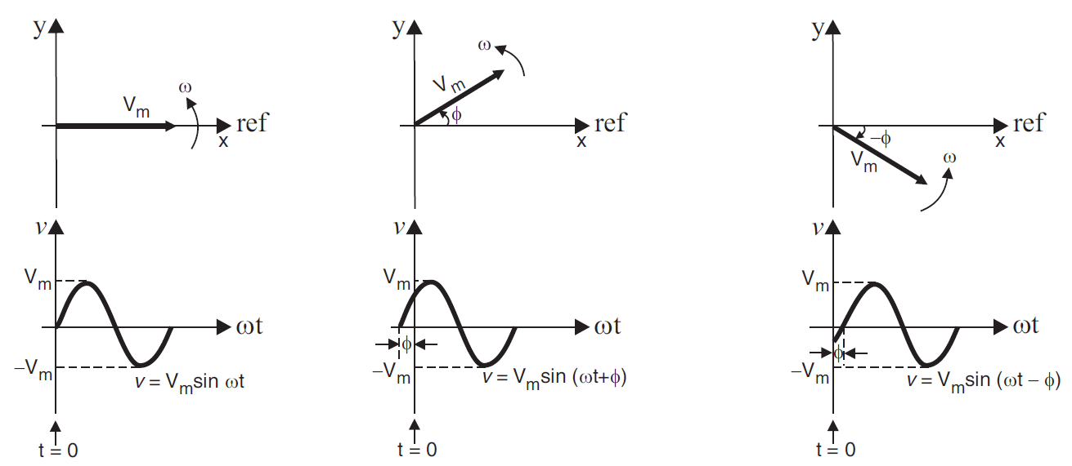
The vector lies on the reference line at time t = 0. Hence, the phase angle of the vector is zero.
The vector is lying at an angle φ ahead of reference at t = 0. Hence, the phase angle of the vector is φ degrees (or radians) leading.
The vector is lying at an angle φ behind the reference at t = 0. Hence, the phase angle of the vector is φ degrees (or radians) lagging

Slide 10
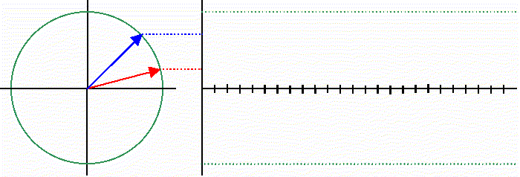
Phase difference
The phase difference between two (or more) sine waves can be estimated only if the frequency of sine waves is the same.

Slide 11
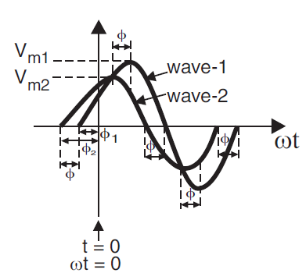
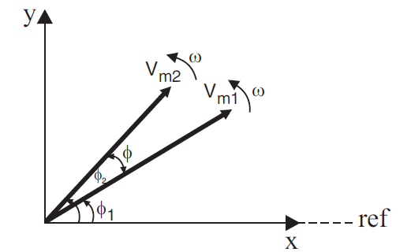

Slide 12
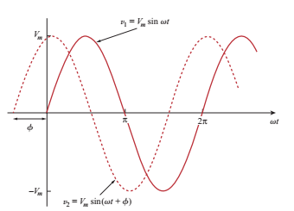
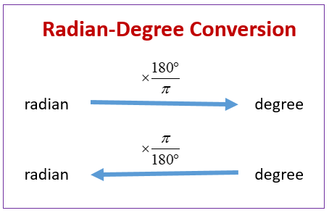
Where ø is the phase
From the figure : The starting point of v₂ occurs first in time. Therefore v₂ leads v₁ by ø or that v₁ lags by v₂ by ø or both v₁ and v₂ are out of phase. If ø = 0, both v₁ and v₂ are in phase.

Slide 13
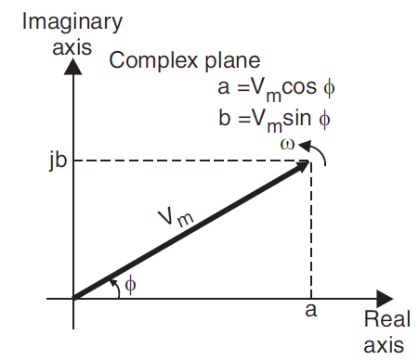
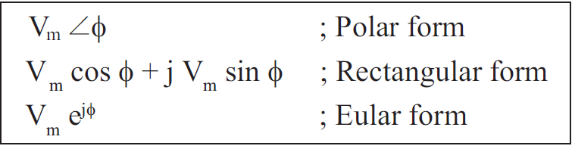

Slide 14
Terminology:
Waveform is a graph which the instantaneous value of any quantity is plotted against time.
Alternating waveform is a wave which reverses its direction at regular recurring intervals of time.
Periodic waveform is one which repeats itself after definite time intervals.
Cycle is one complete set of positive and negative halves.
Amplitude is the maximum positive or negative value of an alternating quantity
Frequency is the number of cycles per second of an alternating quantity.
Period is the time taken to complete one cycle for a periodic waveform
8. Phase is the difference in the angle with respect reference point

Slide 15
Tutorial - 10
Alternating current (AC) Fundamentals
Values of Alternating voltage and current
Phasor representations

Slide 16
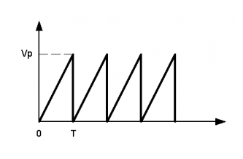
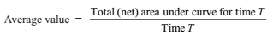
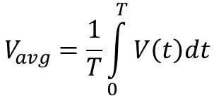
As values of alternating voltage or current varies with respect time, then a question arises to express the magnitude of an alternating quantity.
1. Peak value 2. Average value or mean value 3. R.M. S value or effective value 4. Peak-to-peak value
Average Value

Slide 17
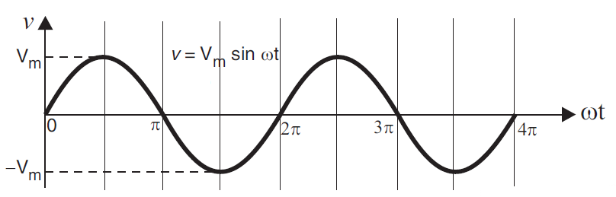
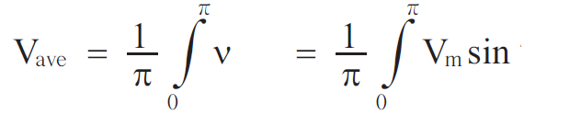
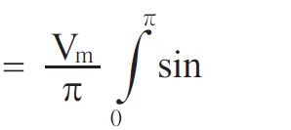
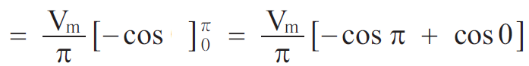
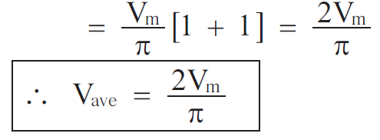
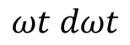
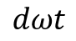
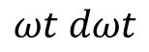
$$dωt$$
$$ωt dωt$$
$$ωt dωt$$

Slide 18
RMS Value
The rms stands for root-mean-square.
The value is obtained by taking the root of the mean of the squared function.
A function is squared
The mean (average) of the squared function is determined and
The root of this mean value is taken.
The rms value is also known as effective value.
The rms value of a time varying quantity is the equivalent dc value of that quantity.
For example, a 5 V dc is equivalent to 5 V rms value of ac.

Slide 19
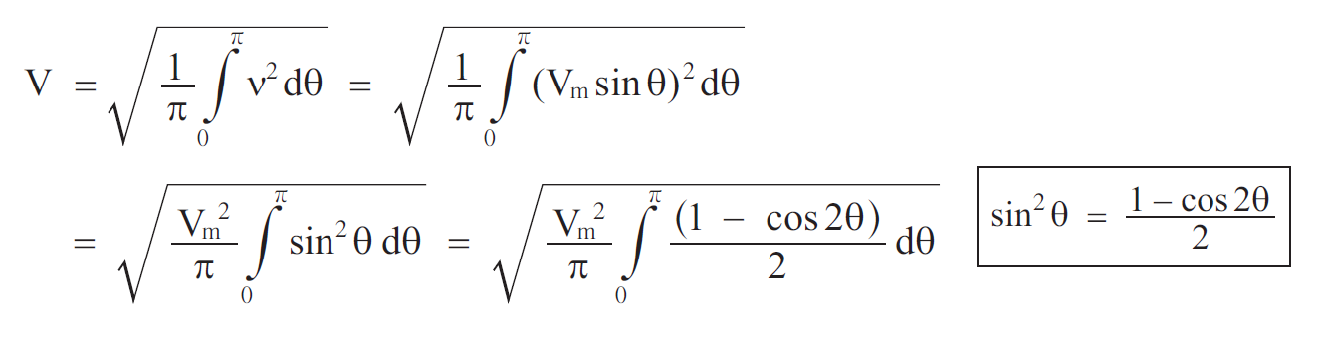
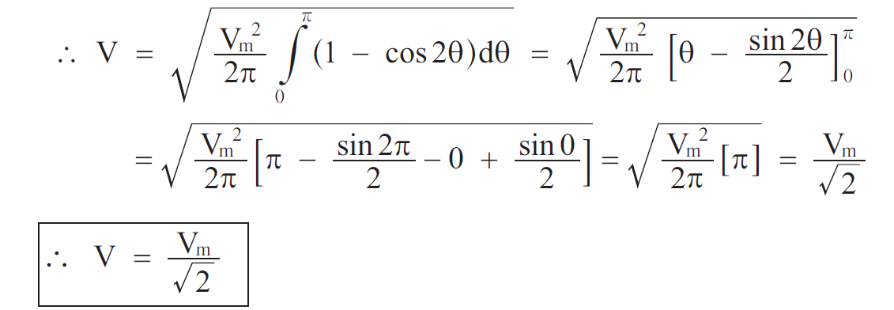
RMS Value of sinusoid

Slide 20
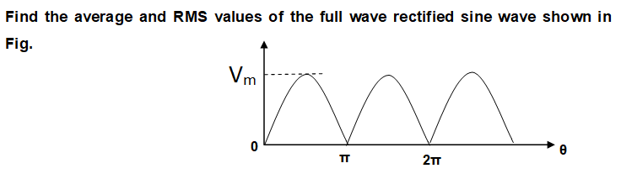
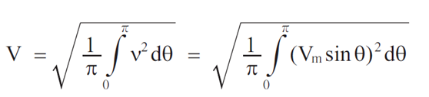
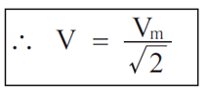

Slide 21
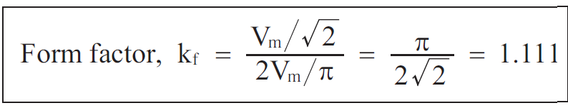
Form factor
Form factor is defined as the ratio of rms value and average value of a periodic waveform.
Form Factor =

Slide 22
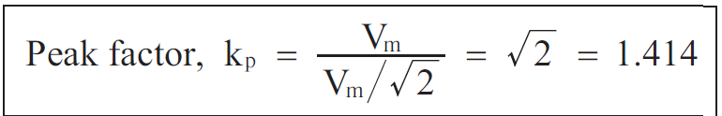
Peak factor
Peak factor is defined as the ratio of peak value (or maximum value) and the rms value of a periodic waveform.
Peak Factor =

Slide 23
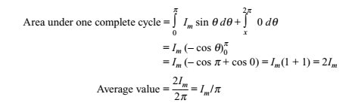

Slide 24
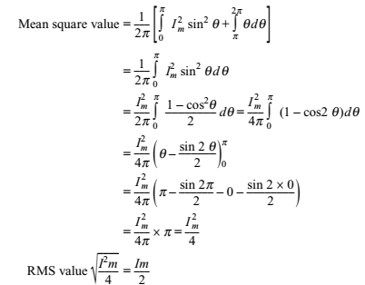

Slide 25
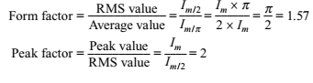

Slide 27
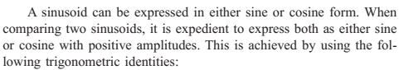
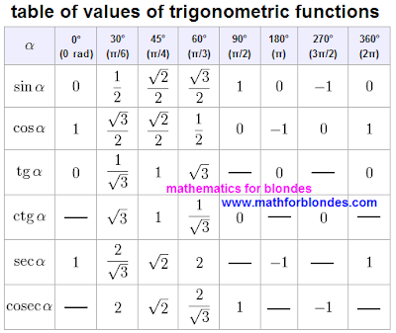
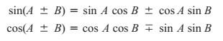
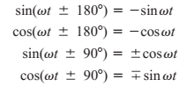
Basics of AC representation

Slide 28
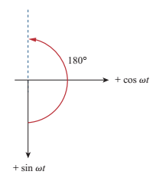
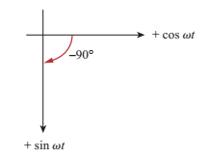
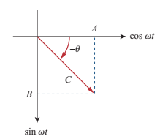
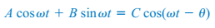
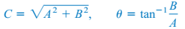
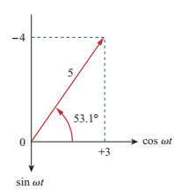
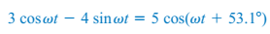

Slide 31
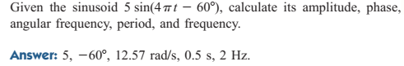

Slide 33



Phasors:

Slide 34








Operations on Complex numbers
Addition
Reciprocal
Subtraction
Square root
Multiplication
Conjugate
Division

Slide 35




As a complex quantity, a phasor may be expressed in rectangular form, or polar form of
exponential form

Slide 36
Tutorial - 11
Problems on Phasors
Single phase AC circuits

Slide 37




Slide 38


Slide 39


Slide 40


Slide 42


Slide 43



Complex power
Complex power is denoted by S and it is defined as the product of rms voltage and the conjugate of RMS current

Slide 44

Apparent power S is defined as the product of the magnitude of rms voltage and rms current

Slide 45


The real part of S is called active power.
Active power is denoted by P and expressed in watts, W.
The imaginary part of S is called reactive power.
Reactive power is denoted by Q and expressed in volt-ampere-reactive, VAR.

Slide 46


The ratio of active power and apparent power is defined as power factor Φ
S
Q
Φ
P
Power factor is also defined as cosine of the phase difference between voltage and current

Slide 47




Resistance Connected to Sinusoidal Source

Slide 48

Resistance consumes only active power and the reactive power in a resistance is zero

Slide 49


Inductance Connected to Sinusoidal Source
The current in an inductance lags behind the voltage by 90⁰ (or)
The voltage across the inductance leads the current in an inductance by 90⁰.

Slide 50

Inductance consumes only reactive power and “the active power in pure inductance is zero.”
The reactive power of inductance is positive, which means that it absorbs reactive power.

Slide 51


Capacitance Connected to Sinusoidal Source
The current in a capacitance leads the voltage across it by 90⁰ (or)
The voltage across the capacitance lags the current in a capacitance by 90⁰

Slide 52

Capacitance has only reactive power and “active power in pure capacitance is zero”.
The reactive power of capacitance is negative, which means that it delivers reactive power.

Slide 53
Impedance
Impedance is defined as the ratio of voltage and current.
Impedance is also defined as the opposition offered to flow of current.
Impedance is a complex quantity and denoted by Z.
The real part of impedance is resistance and the imaginary part of impedance is reactance.
The unit of resistance, reactance and impedance are Ohm.
There are two types of reactance, namely, the inductive reactance and capacitive reactance.
Inductive reactance is denoted by X_{L} and equal to ωL. Capacitive reactance is denoted by X_{C} and equal to 1/ωC.
Inductive and capacitive reactance have the exact opposite behavior.
Therefore, when expressed as a complex quantity, inductive reactance takes a positive value and capacitive reactance takes a negative value

Slide 54



Slide 55




Conductance: The inverse of resistance is conductance
Susceptance: The inverse of reactance is susceptance
Admittance: The inverse of impedance is admittance
The MKS unit of conductance, susceptance and admittance is mho, ℧
The SI unit of conductance, susceptance and admittance is Siemens, S

Slide 59
Tutorial - 11
Problems on Phasors
Single phase AC circuits

Slide 66
Complex power
Complex power is denoted by S and it is defined as the product of rms voltage and the conjugate of RMS current

Slide 67
Apparent power S is defined as the product of the magnitude of rms voltage and rms current

Slide 68
The real part of S is called active power.
Active power is denoted by P and expressed in watts, W.
The imaginary part of S is called reactive power.
Reactive power is denoted by Q and expressed in volt-ampere-reactive, VAR.

Slide 69
The ratio of active power and apparent power is defined as power factor Φ
S
Q
Φ
P
Power factor is also defined as cosine of the phase difference between voltage and current

Slide 70
Resistance Connected to Sinusoidal Source

Slide 71
Resistance consumes only active power and the reactive power in a resistance is zero

Slide 72
Inductance Connected to Sinusoidal Source
The current in an inductance lags behind the voltage by 90⁰ (or)
The voltage across the inductance leads the current in an inductance by 90⁰.

Slide 73
Inductance consumes only reactive power and “the active power in pure inductance is zero.”
The reactive power of inductance is positive, which means that it absorbs reactive power.

Slide 74
Capacitance Connected to Sinusoidal Source
The current in a capacitance leads the voltage across it by 90⁰ (or)
The voltage across the capacitance lags the current in a capacitance by 90⁰

Slide 75
Capacitance has only reactive power and “active power in pure capacitance is zero”.
The reactive power of capacitance is negative, which means that it delivers reactive power.

Slide 76
Impedance
Impedance is defined as the ratio of voltage and current.
Impedance is also defined as the opposition offered to flow of current.
Impedance is a complex quantity and denoted by Z.
The real part of impedance is resistance and the imaginary part of impedance is reactance.
The unit of resistance, reactance and impedance are Ohm.
There are two types of reactance, namely, the inductive reactance and capacitive reactance.
Inductive reactance is denoted by X_{L} and equal to ωL. Capacitive reactance is denoted by X_{C} and equal to 1/ωC.
Inductive and capacitive reactance have the exact opposite behavior.
Therefore, when expressed as a complex quantity, inductive reactance takes a positive value and capacitive reactance takes a negative value

Slide 78
Conductance: The inverse of resistance is conductance
Susceptance: The inverse of reactance is susceptance
Admittance: The inverse of impedance is admittance
The MKS unit of conductance, susceptance and admittance is mho, ℧
The SI unit of conductance, susceptance and admittance is Siemens, S

Slide 82
Tutorial - 12
Problems on Phasors
Single phase AC circuits

Slide 88

Series RLC circuit:

Slide 89



Slide 90



Slide 91



Slide 92


Slide 104
Magnetic Circuits and Induced EMF
Basic Definitions
Magnetic Circuit
Leakage flux and fringing effect
Comparison between magnetic and electric circuit
Electromagnetic induction
Law of Electromagnetic induction
Induced EMF
Self and mutual inductance

Slide 105
Tutorial – 13, 14 and 15
Electromagnetic induction
Law of Electromagnetic induction
Induced EMF
Self and mutual inductance

Slide 106

A magnet is a material or object that produces a magnetic field.
This magnetic field is invisible but is responsible for the most notable property of a magnet:

Slide 107
Magnetic Fields
The strength of a magnetic field in a given region is directly related to the density of flux lines in that region.
Unlike poles of two permanent magnets are brought together the magnets will attract,
like poles are brought together, the magnets will repel
Notes:
4

Slide 108
Magneto Motive Force
The amount of flux density setup in the core is dependent upon five factors
The current
Number of turns
Material of the magnetic core
Length of core and
Cross-sectional area of the core.
More current and the more turns of wire we use, the greater will be the magnetising effect.
We call this product of turns and current the magneto motive force
MMF = NI unit is :Ampere Turns
Input supply
Design parameters

Slide 109


Slide 110


Slide 111


Slide 112

Magnetic Fields
In the region surrounding a Permanent Magnet there exists a magnetic field, which can be represented by Magnetic Flux Lines similar to electric flux lines.
Magnetic Flux Lines differ from electric flux lines in that they don’t have an origin or termination point.
Magnetic Flux Lines radiate from the North Pole to the South Pole through the magnetic bar.
Notes:
3

Slide 113



General Properties of Magnetic Lines of Force
They never cross one another.
Their density decreases with increasing distance from the poles.
They flow from the south pole to the north pole within a material and north pole to south pole in air.
Notes:
11

Slide 114
Leakage Flux
Leakage flux is defined as the magnetic flux which does not follow the particular intended path in a magnetic circuit.
When a current is passed through a solenoid, magnetic flux is produced by it.
Most of the flux is set up in the core of the solenoid and passes through the particular path that is through the air gap and is utilized in the magnetic circuit.
This flux is known as Useful flux φ_{u}.

Slide 115

As practically it is not possible that all the flux in the circuit follows a particular intended path and sets up in the magnetic core and thus some of the flux also sets up around the coil or surrounds the core of the coil, and is not utilized for any work in the magnetic circuit.
This type of flux which is not used for any work is called Leakage Flux and is denoted by φ_{l.}
Therefore, the total flux Φ produced by the solenoid in the magnetic circuit is the sum of the leakage flux and the useful flux and is given by the equation shown below

Slide 116


Leakage coefficient
The ratio of the total flux produced to the useful flux set up in the air gap of the magnetic circuit is called leakage coefficient or leakage factor.
It is denoted by (λ). Ø is total flux, ø_{u} is the useful flux

Slide 117

FRINGING EFFECT
The useful flux when sets up in the air gap, it tends to bulge outward at (b and b’) as show in figure, because of this bulging the effective area of the air gap increases and the flux density of the air gap decreases. This effect is known as Fringing.
Fringing is directly proportional to the length of the air gap that means if the length increases the fringing effect will also be more and vice versa.

Slide 118

Flux and Flux Density
The number of flux lines per unit area is called flux density (B). Flux density is measured in teslas (T).
Notes:
8

Slide 119
Calculating Flux When Area is Not Perpendicular to Field
The flux penetrating the area A when the normal vector n makes an angle of θ with the B-field is:
n
A
θ
α
B
The angle θ is the complement of the angle α that the plane of the area makes with B field. (Cos θ = Sin α)

Slide 120
Example 1: A current loop has an area of 40 cm² and is placed in a 3-Tesla magnetic field at the given angles. Find the flux Φ through the loop in each case.
x x x x x x x x x x x x x x x x
n
n
n
θ
A
A = 40 cm²
(a) θ = 0⁰
(b) θ = 90⁰
(c) θ = 60⁰
(a) Φ = BA cos 0⁰ = (3 T)(0.004 m²)(1); Φ = 12.0 mWb
(b) Φ = BA cos 90⁰ = (3 T)(0.004 m²)(0); Φ = 0 mWb
(c) Φ = BA cos 60⁰ = (3 T)(0.004 m²)(0.5); Φ = 6.00 mWb

Slide 121


DIRECTION OF THE MAGNETIC FLUX LINES
The direction of the magnetic flux lines can be found by placing the thumb of the right hand in the direction of conventional current flow and noting the direction of the fingers (commonly called the right hand rule).
Notes:
7

Slide 122


Slide 123
MAGNETIC FIELD Intensity, or Magnetising force (H)
M.M.F per unit area.
where l is the length of the magnetic circuit
It is a measure of the ability of a magnetised body to produce magnetic induction in other magnetic substances.
The magnetic field produces a magnetic flux, Φ
flux has units of weber (Wb)
Strength of the flux at a particular location is measured in term of the magnetic flux density, B

Slide 124
Relationship Between B & H
B = μH
μ =Permeability
Permeability of free space (vacuum) is
The ratio of the permeability of a material to that of free space is called relative permeability.
Notes:
10

Slide 125

Reluctance: it is the property of an magnetic circuit by which setting up of flux
is opposed. Measured in Amp./Weber and denoted by S

Slide 126

Hysteresis Loop (B-H Loop)
The curve is the result of, when the magnetic material is taken through a complete cycle of magnetization and demagnetization.

Slide 127
Hysteresis Loop (B-H Loop)
It starts with a neutral magnetic material, traversing the B-H loop at the origin X.
As H is increased, the flux density B increases along the dashed line to the saturation point, B_{s}.
When H is now decreased and B is plotted, B-H loop transverses a path to B_{r}, where H is zero and the core is still magnetized.
The flux at this point is called retentivity or remanent flux, and has a flux density, B_{r}.

Slide 128
Hysteresis Loop (B-H Loop)
The magnetizing force, H, is now reversed in polarity to give a negative value.
The magnetizing force required to reduce the flux B_{r} to zero is called the coercive force, H_{c}.
When the core is forced into saturation, the retentivity, B_{rs}, is the remaining flux after saturation, and coercivity, H_{cs}, is the magnetizing force required to reset to zero.

Slide 129
Hysteresis Loop (B-H Loop)
The hysteresis loop represents energy lost in the core.
The enclosed area is a measure of energy lost in the core material during that cycle.

Slide 130



Analysis of simple magnetic circuit
Choose a closed path which follows the average magnetic field line around the interior of the core. Length of this path is called the mean magnetic path length l
H l = Ni
F =H l
Since H = B / μ and B = ϕ / a,
we can express F as
F=R ϕ

Slide 131



Slide 132


Analysis of composite magnetic circuits
The flux lines in the find their closed path through the different magnetic materials and the air gap. Thus, the single significant magnetic flux exists. Hence, the circuit can be termed as series magnetic circuit.

Slide 133


Each part of the series circuit will offer reluctance to the magnetic flux ø.
The amount of reluctance will depend upon the dimensions and relative permeability of that part. Since, different parts of the circuit are in series, the total reluctance is equal to the sum of reluctances of individual parts.
S = S1 + S2 + S3 + Sg

Slide 134


Slide 135


Parallel magnetic circuit
In a magnetic circuit, if the flux has more than one path, then it is known as a parallel magnetic circuit. In most of the electrical machines magnetic circuits exists in parallel.

Slide 136




In parallel magnetic circuit, the total flux exists in a common section of the
magnetic circuit which contains the exciting coil.

Slide 137

Comparison between magnetic and electric circuit

Slide 138


Slide 146
Tutorial - 16
Electromagnetic induction
Law of Electromagnetic induction
Induced EMF
Self and mutual inductance

Slide 147



Faraday’s Law of Electromagnetic Induction
First Law:
Whenever a conductor is placed in a magnetic field, due to the relative motion between the conductor and magnetic field an EMF is induced.
OR
When a moving conductor cuts the magnetic field, an emf induced in it which is called as dynamic emf.
Second Law:
The magnitude of the induced emf is equal to the rate of change of flux linkage.
Lenz’s law:
This states that any induced emf will circulate a current in such a direction so as to oppose the cause producing it.

Slide 154


Left hand thumb rule:
Thumb – Direction of force – Input
Fore finger – Direction of the magnetic field – Medium
Middle finger – Direction of Current – Output
Applied for the Motor
Right hand thumb rule:
Thumb – Direction of force – Output
Fore finger – Direction of the magnetic field – Medium
Middle finger – Direction of Current – Input
Applied for the Generator

Slide 169
Working principle and Commutator action in DC Generator
Armature Reaction
Construction of DC Generator
Types of DC Generators
Characteristics of DC Generators
Applications

Slide 170
Generators
Function:
Generators are the electrical machines which convert mechanical energy into electrical energy.
GENERATOR
Mechanical
Energy
Electrical
Energy

Slide 171
Working Principle of a DC Generator:
According to Faraday’s laws of electromagnetic induction, whenever a conductor is placed in a varying magnetic field (OR a conductor is moved in a magnetic field), an emf (electromotive force) gets induced in the conductor.
The magnitude of induced emf can be calculated from the emf equation of dc generator.
If the conductor is provided with the closed path, the induced current will circulate within the path.
In a DC generator, field coils produce an electromagnetic field and the armature conductors are rotated into the field.
Thus, an electromagnetically induced emf is generated in the armature conductors.
The direction of induced current is given by Fleming’s right hand rule

Slide 172

Illustration of working of a DC Generator

Slide 173


Generator working principle ins steps:
Case I: θ=0º
The velocity component (v) is in parallel with the flux lines or in other words, the angle between the velocity and flux lines is zero.
Hence the emf induced is zero.
E=0
Case II: 0º< θ < 90º
The velocity component is making an angle with the flux lines.
The velocity component is resolved into two components
Vsinθ
The vsinθ is 90º with respect to flux lines and it is doing useful work and due to this, emf is induced.
e_{min}<e<e_{max}

Slide 174

Case III: θ = 90º
The velocity component is making an angle 90º with the flux lines and due to this, emf is induced.
E=e_{max}
For remaining cases, the illustration is shown below,
The emf completes one complete cycle for 360º .

Slide 175

Emf induced is the alternating type
BECAUSE
during positive half cycle, the conductor comes under the influence of north pole
during negative half cycle, the conductor comes under the influence of south pole
How to convert AC to DC?
It is observed that the emf induced is the alternating type, but it is required to obtain unidirectional emf from the DC machines.
The alternating emf can be converted into pulsating dc using the split ring/commutator.

Slide 176



Commutator Action
Copper segments
During negative half cycle, the time at which the current changes the direction, the segment A will move to Q and B will move to P.
During positive half cycle, A segment will be at P and B will be at Q.

Slide 177


Single loop or coil generator
Multi loop or coil generator

Slide 178
EMF equation in DC Generator
For one revolution of the conductor,
Let, Φ = Flux produced by each pole in Weber (Wb)
P = number of poles in the DC generator
Total flux produced by all the poles = Φ * P
Time taken to complete one revolution = 60/ N
N is the speed of the armature conductor in rpm.
Now, according to Faraday’s law of induction, the induced emf of the armature conductor is denoted by “e” which is equal to rate of cutting the flux.

Slide 179


Let us suppose there are
Z total numbers of conductor in a generator, and arranged in such a manner that all parallel paths are always in series. Here,
A = number of parallel paths
Then, Z/A = number of conductors connected in series
We know that Induced emf in each path is same across the line
Therefore, Induced emf of DC generator
E = Emf of one conductor × number of conductor connected in series.

Slide 180

Simple wave wound generator Numbers of parallel paths are only 2 = A. Lap-wound generator Here, number of parallel paths is equal to number of conductors in one path i.e. P = A Therefore,

Slide 181
MNA and GNA
Armature Reaction
Def: The interaction of armature flux with main field flux is called as armature reaction.
As long as the armature is not connected with the load, there is no armature reaction
When the load is connected to the armature, the current flows in the armature and it produces armature flux. This interacts with the main field flux.
MNA: magnetic neutral axis- axis along which there is zero emf. (Commutation axis)
GNA: Geometric neutral axis: axis of symmetry between the poles.
De-magnetizing effect reduces the magnitude of field flux so that it reduces the net flux.
Cross magnetizing effect distorts the field flux.
Magnetizing effect saturates the field poles.

Slide 182

Case 1: only field flux, no armature flux
MNA (magnetic neutral axis), GNA (geometric neutral axis) coincides
with each other

Slide 183

Case 2: no field, only armature flux
MNA (magnetic neutral axis), GNA (geometric neutral axis) coincides with each other

Slide 184

Case 3: Both field and armature flux
F_{d}
F_{F}
Fd - Demagnetizing flux opposes Ff
Fc - Cross magnetizing perpendicular to Ff
F_{R}
Fc

Slide 185

Construction of a DC generator
Stationary parts: Yoke, Field poles, Pole shoe, Field windings,
Moving parts: Armature core, Armature winding, Commutator, Brushes

Slide 186


Slide 187


Stationary Parts
Yoke:
The outer frame of a dc machine is called as yoke.
It is made up of cast iron or steel.
It not only provides mechanical strength to the whole assembly but also carries the magnetic flux produced by the field winding
Poles and pole shoes:
Poles are joined to the yoke with the help of bolts or welding.
They carry field winding and pole shoes are fastened to them.
Pole shoes serve two purposes;
(i) They support field coils
(ii) Spread out the flux in air gap uniformly

Slide 188


Field winding:
They are usually made of copper.
Field coils are former wound and placed on each pole and are connected in series.
They are wound in such a way that, when energized, they form alternate North and South poles

Slide 189

Rotating parts of the DC machine
Armature core:
Armature core is the rotor of the machine.
It is cylindrical in shape with slots to carry armature winding.
The armature is built up of thin (about 0.4 to 0.6 mm thick) laminated circular steel disks for reducing eddy current losses.
It may be provided with air ducts for the axial air flow for cooling purposes. Armature is keyed to the shaft
Practical D.C machines have air gaps ranging from 0.5 mm to 1.5 mm.

Slide 190
Armature winding:
It is usually a former wound copper coil which rests in armature slots.
The armature conductors are insulated from each other and also from the armature core.
Armature winding can be wound by one of the two methods; Lap and Wave
Commutator and brushes:
Physical connection to the armature winding is made through a commutator-brush arrangement.
The function of a commutator, in a dc generator, is to collect the current generated in armature conductors.
Whereas, in case of a dc motor, commutator helps in providing current to the armature conductors.
A commutator consists of a set of copper segments which are insulated from each other.

Slide 191

A commutator is a mechanical rectifier which converts the alternating voltage generated in the armature winding into direct voltage across the brushes.
The number of segments is equal to the number of armature coils.
Each segment is connected to an armature coil and the commutator is keyed to the shaft.
Brushes
are usually made from carbon or graphite. They rest on commutator segments and slide on the segments when the commutator rotates keeping the physical contact to collect or supply the current.

Slide 192


Slide 193
Methods of Excitation
Excitation
Separate Excitation
Self Excitation
Series Excitation
Shunt Excitation
Compound Excitation
Cumulative Compound
Differential Compound
Short Shunt
Long Shunt

Slide 194

Types of Generator
Permanent Magnet Generator
When the flux in the magnetic circuit is established by the help of permanent magnets then it is known as Permanent magnet dc generator.
This type of dc generators generates very low power. So, they are rarely found in industrial applications.
They are normally used in small applications like dynamos in motor cycles.

Slide 195

Separately Excited Generator
These are the generators whose field magnets are energized by some external dc source such as battery .
I_{a} = Armature current I_{L} = Load current V = Terminal voltage E_{g} = Generated emf
Voltage drop in the armature = I_{a} × R_{a} (Ra is the armature resistance) Let, I_{a} = I_{L} = I (say) Then, voltage across the load, V = E_{g} - IR_{a} Power generated, P_{g} = E_{g}×I Power delivered to the external load, P_{L} = V×I.

Slide 196
Self Excited Generator
These are the generators whose field magnets are energized by the electric current supplied by themselves.
In these type of machines field coils are internally connected with the armature.
Due to residual magnetism some flux is always present in the poles. When the armature is rotated some emf is induced. Hence some induced electric current is produced.
As the pole flux strengthened, it will produce more armature emf, which cause further increase of electric current through the field.
This increased field electric current further raises armature emf and this cumulative phenomenon continues until the excitation reaches to the rated value.

Slide 197

Series Wound Generator
In these type of generators, the field windings are connected in series with armature conductors
whole electric current flows through the field coils as well as the load.
As series field winding carries full load electric current it is designed with relatively few turns of thick wire. The electrical resistance of series field winding is therefore very low (nearly 0.5Ω ).
R_{sc} = Series winding resistance, I_{sc} = Current flowing through the series field
I_{a} = I_{sc} = I_{L}=I (say) Voltage across the load V = E_{g} -I(R_{a}+R_{sc}), Power generated P_{g} = E_{g}×I Power delivered to the load P_{L} = V×I

Slide 198

Shunt Wound Generator
In these type of DC generators the field windings are connected in parallel with armature conductors
In shunt wound generators the voltage in the field winding is same as the voltage across the terminal.
The effective power across the load will be maximum when I_{L} will be maximum.
So, it is required to keep shunt field electric current as small as possible.
For this purpose the resistance of the shunt field winding generally kept high (100 Ω) and large no of turns are used for the desired emf.
R_{sh} = Shunt winding resistance I_{sh} = Current flowing through the shunt field
I_{a}=I_{sh} + I_{L}
Shunt field current, I_{sh} = V/R_{sh} Voltage across the load, V = E_{g}-I_{a} R_{a} Power generated, P_{g}= E_{g}×I_{a} Power delivered to the load, P_{L} = V×I_{L}

Slide 199
Compound Wound Generator
In a compound-wound generator, there are two sets of field windings on each pole—one is in series and the other in parallel with the armature. This combination of windings is called compound wound DC generator.
Compound wound generators have both series field winding and shunt field winding. One winding is placed in series with the armature and the other is placed in parallel with the armature.
This type of DC generators may be of two types-
short shunt compound wound generator and
long shunt compound wound generator

Slide 200

Compound Wound Generator (Short Shunt)
The generators in which only shunt field winding is in parallel with the armature winding as shown in figure.
Series field current, I_{sc} = I_{L} Shunt field current, I_{sh} = (V+I_{sc} R_{sc})/R_{sh} Armature current, I_{a} = I_{sh} + I_{L} Voltage across the load, V = E_{g} - I_{a} R_{a} - I_{sc} R_{sc} Power generated, P_{g} = E_{g}×I_{a} Power delivered to the load, P_{L}=V×I_{L}

Slide 201

Compound Wound Generator (Long Shunt)
The generators in which shunt field winding is in parallel with both series field and armature winding as shown in figure.
Shunt field current, I_{sh}=V/R_{sh} Armature current I_{a}= series field current I_{sc}= I_{L}+I_{sh} Voltage across the load V=E_{g}-I_{a}R_{a}-I_{sc} R_{sc}
=E_{g}-I_{a} (R_{a}+R_{sc}) [∴I_{a}=I_{cs}] Power generated, P_{g}= E_{g}×I_{a} Power delivered to the load, P_{L}=V×I_{L}

Slide 202

Compound Wound Generator (Cumulative & Differential Compound)
In a compound wound generator, the shunt field is stronger than the series field.
When the series field assists the shunt field, generator is said to be commutatively compound wound.
On the other hand if series field opposes the shunt field, the generator is said to be differentially compound wound.

Slide 203
DC Generator
Note: V_{T} = V_{L}
i.e. Terminal Voltage is the Load Voltage

Slide 204
DC Generator Characteristic
Open Circuit Characteristic (O.C.C.)
Generated emf at no load (E₀) and the field current (I_{f}) at a given fixed speed
Internal or Total characteristic (E_{g} /I_{a})
relation between the on-load generated emf (E_{g}) and the armature current (I_{a})
External characteristic (V/I_{L})
relation between terminal voltage (V) & the load current (I_{L}).

Slide 205
Open Circuit Characteristic (O.C.C.)
This characteristic is also known as magnetic characteristic or no-load saturation characteristic.
The O.C.C. curve is just the magnetization curve and it is practically similar for all type of generators.
The data for O.C.C. curve is obtained by operating the generator at no load and keeping a constant speed.
Field current is gradually increased and the corresponding terminal voltage is recorded.

Slide 206
Now, from the emf equation of dc generator, we know that
Eg = kɸ.
Hence, the generated emf should be directly proportional to field flux (and hence, also directly proportional to the field current).
However, even when the field current is zero, some amount of emf is generated (represented by OA in the figure below).
This initially induced emf is due to the fact that there exists some residual magnetism in the field poles.
Due to the residual magnetism, a small initial emf is induced in the armature.

Slide 207
This initially induced emf aids the existing residual flux, and hence, increasing the overall field flux.
This consequently increases the induced emf. Thus, O.C.C. follows a straight line.
However, as the flux density increases, the poles get saturated and the ɸ becomes practically constant.
Thus, even we increase the I_{f} further, ɸ remains constant and hence, Eg also remains constant.
Hence, the O.C.C. curve looks like the B-H characteristic.

Slide 208


Slide 209

Open Circuit Characteristic (O.C.C.)

Slide 210
Internal AND external
characteristic curves
for each type of generator.

Slide 211
Internal or Total characteristic (E_{g} /I_{a})
An internal characteristic curve shows the relation between the on-load generated emf (Eg) and the armature current (I_{a})
The on-load generated emf Eg is always less than E₀ due to the armature reaction.
Eg can be determined by subtracting the drop due to demagnetizing effect of armature reaction from no-load voltage E₀. Therefore, internal characteristic curve lies below the O.C.C. curve.

Slide 212

External characteristic (V/I_{L})
This characteristic curve shows the relation between terminal voltage (V) and the load current (I_{L}).
Terminal voltage V is less than the generated emf Eg due to voltage drop in the armature circuit.
External characteristics are very important to determine the suitability of a generator for a given purpose.
Therefore, This type of characteristic is sometimes also called as Performance Characteristic or Load Characteristic.

Slide 213

Characteristics of Separately Excited DC Generator
If there is no armature reaction & armature voltage drop, the voltage will remain constant for any load current.
Thus, the straight line AB in above figure represents the no-load voltage vs. I_{L}
Due to the demagnetizing effect of armature reaction, the on-load generated emf is less than the no-load voltage.
The curve AC represents the on-load generated emf Eg vs load current I_{L} i.e. internal characteristic (as I_{a} = I_{L} for a separately excited dc generator).
Also, the terminal voltage is lesser due to ohmic drop occurring in the armature and brushes. The curve AD represents the terminal voltage vs. load current

Slide 214


Characteristics Of DC Shunt Generator

Slide 215


Characteristics Of DC Series Generator

Slide 216
Applications of DC Generators
Shunt generators are used in applications, such as for battery charging, dc excitation in ac generators, lighting applications etc.
A series generator’s load characteristic is a rising one. That is, as the load increases, voltage increases due to increase in field current.
Such generators cannot be used for lighting applications as voltage variation will effect illumination level. However, dc series generators can be used to boost up voltage of an existing system to compensate for the voltage drop in the system. Series generators are also used as welding generators and in arc lamps.
The characteristics of dc compound generators can be modified by the use of series winding either in cumulative or in differential mode. Lighting and power supply for heavy vehicles and arcing applications

Slide 217
Tutorial - 20
Working principle of motor
Types of DC Motors
Characteristics of DC Motors
Applications of DC motors
Starter

Slide 218
MOTORS
Function:
Motors are the electrical machines which convert electrical energy into mechanical energy.
MOTORS
Electrical
Energy
Mechanical
Energy

Slide 219

Physical structure
Current carrying in the conductor

Slide 220

Magnetic field

Slide 221


Resultant force

Slide 222


Slide 223

When current flows in a conductor it produces a magnetic field about it - as shown in (a) below
when the current-carrying conductor is within an externally generated magnetic field, the fields interact and a force is exerted on the conductor - as in (b)

Slide 224
Working Principle of a DC Motor
A motor is an electrical machine which converts electrical energy into mechanical energy.
The principle of working of a DC motor
is that "whenever a current carrying conductor is placed in a magnetic field, it experiences a mechanical force".
The direction of this force is given by Fleming's left hand rule and
it's magnitude is given by F = BIL.
Where, B = magnetic flux density,
I = current and
L = length of the conductor within the magnetic field.

Slide 225


Concept of back emf (E_{b})
A motor has coils turning inside magnetic fields, and a coil turning inside a magnetic field induces an emf. As per Lenz’s law, this induced emf opposes the voltage applied to the armature. Hence, it is called the counter or back emf.
There also occurs a potential drop in the armature circuit due to its resistance.
Thus, the applied voltage has to overcome the back emf in addition to supplying the armature circuit drop and producing the necessary torque for the continuous rotation of the armature.

Slide 226




Types of DC Motors and Electrical Equivalent
DC Shunt Motor:
DC Compound motor: Long shunt motor
DC Series Motor:
Short shunt motor

Slide 227


Torque and speed equations of DC motors
Ta – Armature torque
P – number of poles
Z – number of conductors
A – number of parallel paths
Ia – Armature current
N – Speed in rpm
ø – flux in webers
V – Supply voltage

Slide 228



Characteristics of motor
Electrical (Ia, Ta)
Mechanical (Ia,N) and (Ta, N)
Characteristics of DC Series Motor
N/T_{a} Characteristic (Mechanical)

Slide 229



T_{a}/I_{a} Characteristic
T_{a} ∝ ΦI_{a}.
T_{a} ∝ Φi_{a}
∴ T_{a} ∝ I_{a}² before saturation
T_{a} ∝ I_{a} after saturation
N/I_{a} Characteristic
N ∝ E_{b}/Φ
Series motor cannot be started with no load.

Slide 230


DC Shunt Motor
Torque V_{s} Armature current characteristic
T_{a} ∝ Φi_{a}
flux Φ is constant

Slide 231



Speed V_{s} Armature Current Characteristic
Speed V_{s} Armature Torque
Ø is constant

Slide 232



Compound motor

Slide 233


Slide 234



Starters
Starters are used to reduce initial high current
When the motor is standstill (not running), N is zero and results in E_{b} is zero
E_{b} is zero and Ra is very small , consequently dangerous amount of current will allows to flow in armature winding and it may damages the motor.
To limit such inrush currents an additional resistance is
connected in series with the armature winding while
starting the motor is known as Starter.

Slide 235


Slide 236
Tutorial - 16
Transformer principle and EMF equation
Ideal and practical transformer
Transformer working and construction
Transformer regulation and efficiency
Transformer applications

Slide 237
Working Principle

Slide 238


It is based on principle of MUTUAL INDUCTION. According to which an e.m.f. is induced in a coil when current in the neighboring coil changes.

Slide 239


Slide 240


Slide 241


Slide 242
Classification of transformer based on the core construction

Slide 244


Slide 245


Slide 246
Ideal Transformer
In order to develop the mathematical model of a transformer, it is convenient
to visualize a circuit element termed the ‘ideal’ transformer by making some
certain assumptions in the realistic transformer.
1) The transformer windings are resistance-less.
2) The transformer core material has infinite permeability so that it requires zero
mmf to create flux in the core.
3) The leakage flux is negligible, i.e., no reactive voltage drops in winding
4) The transformer core losses are negligible.
5) Voltage regulation is zero.
6) Efficiency is 100%

Slide 247

Phasor diagram for the ideal transformer
V1, I1 are the supply voltage and current
E1, E2 are the induced emf in primary and secondary windings of the transformer

Slide 248
Practical transformer
All the constructed transformers are practical and their characteristics as below:
There is a leakage flux
Hysteresis and eddy current losses are considered in the core material
The winding consists of a ohmic loss
Voltage regulation is never zero.
Efficiency is 93% - 98%

Slide 249

Phasor diagram for the practical transformer under no-load
V1, I1 are the supply voltage and current
E1, E2 are the induced emf in primary and secondary windings of the transformer
Im is the magnetizing component of current
Iw is the working component of current
Io is the no-load current

Slide 250

Practical transformer with loading

Slide 251


Voltage regulation of a transformer
The voltage regulation of a transformer as low as possible for better operation of
a practical transformer.

Slide 252

Efficiency of a transformer
Core losses – Hysteresis and eddy current losses
Copper losses – Primary and secondary winding resistance losses

Slide 254



Step-up or down the voltage or current
Isolation device
Impedance matching

Slide 255
Tutorial - 23
Concept of rotating magnetic field
Working principle of three-phase induction motor
Construction of three-phase induction motor
Comparison between slip-ring and squirrel cage Motors
Applications

Slide 256
The three phase induction motor is the most widely used electrical motor.
Almost 80% of the mechanical power used by industries is provided by three phase induction motors because of its
simple and rugged construction,
low cost,
good operating characteristics,
absence of commutator and
good speed regulation

Slide 257

Developing a Rotating Magnetic Field
The stator is connected to a three-phase AC power source.
The windings A1 and A2 connected to phase A.
The windings B1 and B2 will be connected to phase B,
The windings and C1 and C2 will be connected to phase C of the power supply.

Slide 258

Note that
The windings A1, B1, and C1 are 120° apart.
The windings A2, B2, and C2 also are 120° apart.
This corresponds to the 120° separation between each electrical phase.

Slide 259

When AC voltage is applied to the stator, the magnetic field developed in a set of phase coils depends on the direction of current flow.
This chart assumes that a positive current flow in the A1, B1 or C1 windings results in a north pole.

Slide 260


Slide 261


Slide 262


Slide 263


Slide 264

Synchronous speed (N_{S})
The speed of the rotating magnetic field is referred to as the synchronous speed (NS) of the motor.
Synchronous speed is equal to 120 times the frequency (F), divided by the number of motor poles (P).

Slide 265
Working Principle:
Current carrying conductor placed in a magnetic field experiences a force.
The two magnetic fields interact with each other to produce mechanical force.
The stator windings are supplied with three phase AC supply.
The rotating magnetic field is produced which rotates with synchronous speed with the constant magnitude of 1.5φ_{m.}
The rotating magnetic field sweeps the rotor surface.
The emf is induced in the rotor as per the faraday’s law of electromagnetic induction.
The rotor bars are short circuited and hence current flows in the bars.
The current carrying conductor produces rotor magnetic field which interact with stator magnetic field to produce torque.

Slide 266
The RMF rotates with the magnitude of 1.5ɸm and with the speed of synchronous speed which is given by Ns=120f/p, where f is the frequency and p is the number of poles.
The rotor of the induction motor is always rotating less than Ns, (i.e., Nr < Ns). The difference between these two speeds is named as slip speed (S). S = Ns – Nr
When the speed difference is zero (i.e., Ns = Nr), No induced emf in the rotor conductors and there is no rotor flux. Consequently, there is no interaction between stator field and rotor field and motor comes to standstill position (stops rotating)
Thus, always rotor rotates always less than Ns.

Slide 267
Construction of Three Phase Induction Motor
Stator:
As its name indicates stator is a stationary part of induction motor.
A stator winding is placed in the stator of induction motor and the three phase supply is given to it.
Rotor:
The rotor is a rotating part of induction motor. .
The rotor is connected to the mechanical load through the shaft.
The rotor of the three phase induction motor are further classified as
Squirrel cage rotor,
Slip ring rotor or wound rotor or phase wound rotor.

Slide 268
Depending upon the type of rotor construction used the
Squirrel cage induction motor,
Slip ring induction motor or wound induction motor or phase wound induction motor.
The construction of stator for both the kinds of three phase induction motor remains the same.
The other parts, are:
Shaft for transmitting the torque to the load. This shaft is made up of steel.
Bearings for supporting the rotating shaft.
One of the problems with electrical motor is the production of heat during its rotation. In order to overcome this problem we need fan for cooling.

Slide 269
For receiving external electrical connection Terminal box is needed.
There is a small distance between rotor and stator which usually varies from 0.4 mm to 4 mm. Such a distance is called air gap.
Stator
Stator frame,
Stator core,
Stator winding or field winding

Slide 270
Stator Frame
It is the outer most part of the three phase induction motor.
Its main function is to support the stator core and the field winding.
It acts as a covering
it provide protection and mechanical strength to all the inner parts of the induction motor.
The frame is either made up of die cast or fabricated steel.
The frame of three phase induction motor should be very strong and rigid as the air gap length of three phase induction motor is very small,

Slide 271
Stator Core
The main function of the stator core is to carry the alternating flux.
In order to reduce the eddy current loss, the stator core is laminated.
These laminated types of structure are made up of stamping which is about 0.4 to 0.5 mm thick.
All the stamping are stamped together to form stator core, which is then housed in stator frame.
The stamping is generally made up of silicon steel, which helps to reduce the hysteresis loss occurring in motor.

Slide 272


Stator Frame
Stator Core

Slide 273
Stator Winding or Field Winding
The slots on the periphery of stator core of the three phase induction motor carries three phase windings.
This three phase winding is supplied by three phase ac supply.
The three phases of the winding are connected either in star or delta depending upon which type of starting method is used.
The squirrel cage motor is mostly started by star – delta starter and hence the stator of squirrel cage motor is delta connected.
The slip ring three phase induction motor are started by inserting resistances so, the stator winding of slip ring induction motor can be connected either in star or delta.

Slide 274

The winding wound on the stator of three phase induction motor is also called field winding and when this winding is excited by three phase ac supply it produces a rotating magnetic field

Slide 275
Types of Three Phase Induction Motor
Squirrel cage three phase induction motor
The rotor of the squirrel cage three phase induction motor is cylindrical in shape and have slots on its periphery.
The slots are not made parallel to each other but are bit skewed as the skewing prevents magnetic locking of stator and rotor teeth and makes the working of motor more smooth and quieter.
The squirrel cage rotor consists of aluminium bars or copper bars.

Slide 276
These aluminium bar or copper bars are called rotor conductors and are placed in the slots on the periphery of the rotor.
The rotor conductors are permanently shorted by the copper or aluminium rings called the end rings.
In order to provide mechanical strength these rotor conductor are braced to the end ring and hence form a complete closed circuit resembling like a cage and hence got its name as "squirrel cage induction motor".
The squirrel cage rotor winding is made symmetrical.
The rotor resistance is very small and it is not possible to add external resistance as the bars are permanently shorted.

Slide 277


Slide 278

The absence of slip ring and brushes make the construction of Squirrel cage three phase induction motor very simple and robust and hence widely used three phase induction motor.
These motors have the advantage of adapting any number of pole pairs.

Slide 279

End Ring

Slide 280



Slide 281

SQUIRREL CAGE ROTOR

Slide 282
Advantages of squirrel cage induction rotor-
Its construction is very simple and rugged.
As there are no brushes and slip ring, these motors requires less maintenance.
Applications:
lathes,
drilling machine,
fan,
blower printing machines etc

Slide 283

Slip ring or wound three phase induction motor

Slide 284

SLIP RING OR WOUNDED ROTOR

Slide 285
The rotor also carries star or delta winding similar to that of stator winding.
The rotor consists of numbers of slots and rotor winding are placed inside these slots.
The three end terminals are connected together to form star connection.
As its name indicates three phase slip ring induction motor consists of slip rings connected on same shaft as that of rotor.
The three ends of three phase windings are permanently connected to these slip rings.

Slide 286
The external resistance can be easily connected through the brushes and slip rings and hence used for speed control and improving the starting torque of three phase induction motor.
The brushes are used to carry current to and from the rotor winding.
These brushes are further connected to three phase star connected resistances.
At starting, the resistance are connected in rotor circuit and is gradually cut out as the rotor pick up its speed.
When the motor is running the slip ring are shorted by connecting a metal collar, which connect all slip ring together and the brushes are also removed.

Slide 287
This reduces wear and tear of the brushes.
Due to presence of slip rings and brushes the rotor construction becomes somewhat complicated therefore it is less used as compare to squirrel cage induction motor.
Advantages of slip ring induction motor -
It has high starting torque and low starting current.
Possibility of adding additional resistance to control speed.
Application:
Slip ring induction motor are used where high starting torque is required i.e in hoists, cranes, elevator etc.

Slide 288
Slip ring or phase wound Induction motor | Squirrel cage induction motor
Construction is complicated due to presence of slip ring and brushes | Construction is very simple
The rotor winding is similar to the stator winding | The rotor consists of rotor bars which are permanently shorted with the help of end rings
We can easily add rotor resistance by using slip ring and brushes | Since the rotor bars are permanently shorted, its not possible to add external resistance
Due to presence of external resistance high starting torque can be obtained | Staring torque is low and cannot be improved
Slip ring and brushes are present | Slip ring and brushes are absent
Frequent maintenance is required due to presence of brushes | Less maintenance is required
The construction is complicated and the presence of brushes and slip ring makes the motor more costly | The construction is simple and robust and it is cheap as compared to slip ring induction motor
This motor is rarely used only 10 % industry uses slip ring induction motor | Due to its simple construction and low cost. The squirrel cage induction motor is widely used
Rotor copper losses are high and hence less efficiency | Less rotor copper losses and hence high efficiency
Speed control by rotor resistance method is possible | Speed control by rotor resistance method is not possible

Slide 289
Tutorial - 25
Construction of Synchronous machine
Working principle of Synchronous alternator
Working principle of Synchronous motor
Comparison between Synchronous and Induction motor
Single – phase Induction Motor
Working of single – phase induction motor
Double field revolving theory
Types of Single – phase Induction motors
Applications

Slide 290
Synchronous machine
The rotor of the three-phase machine revolving with synchronous speed, it is known as synchronous machine.
If the three-phase electrical output is obtained from the stator conductors of the synchronous machine known as synchronous generator or alternator (used in generating stations)
If the three-phase electrical supply is given to the stator conductors to rotate the rotor known as motor.
The construction of both alternator and synchronous motor is same except the type of input.

Slide 291
Constructional features of a Synchronous machine:
Stator
It is the stationary part of the synchronous machine.
It is built with a stack of laminated steel sheets.
The inner periphery of the stator consists of slots to accommodate armature winding.
The armature winding is star-connected and the neutral conductor is connected to ground.

Slide 292



Stator core
Stator core with armature windings

Slide 293
Rotor
The rotating part of the alternator is called a rotor.
It carries field windings, and it is excited by a separate DC supply (field excitation).
Since the rotor is rotating, the excitation voltage is given through slip rings and brushes.
The two different types of rotors used in an alternator are:
Salient or projected pole type
Non-salient or cylindrical pole type

Slide 294



Salient pole synchronous machine

Slide 295


Non – salient pole or cylindrical synchronous machine

Slide 296
Working principle of synchronous generator or alternator:
The working principle of an alternator is similar to that of DC generator. (Faraday’s law of electromagnetic induction)
The current is induced in the conductor inside a magnetic field when there is a relative motion between that conductor and the magnetic field.
The prime movers are used to rotate the rotor and field windings.
As the rotor rotates, the stationary armature conductors are cut by the magnetic flux.
Due to the principle of electromagnetic induction, an emf is induced in the stator conductors.

Slide 297


Since the rotor poles are alternative in nature, the induced emfs in the stator conductors are also alternating in nature and their directions are given by Fleming’s right hand rule.
The frequency of the induced emf depends on the number of N and S poles that the armature conductors pass in one second.

Slide 298

Alternator used in hydro electric power plant

Slide 299
Synchronous Motor
When a three-phase supply is given to the stator of a three-phase alternator, it works as a motor.
The rotating magnetic field, is magnetically locked with this field and rotates at the same speed.
The rotor speed of this machine is equal to the synchronous speed of the stator magnetic field.
The speed of this motor is constant irrespective of the load.

Slide 300
Synchronous motor working :
It is a doubly excited machine.
The three-phase stator winding is fed by a three-phase supply and the rotor is provided with a DC supply.
The three-phase currents in the stator windings produce a rotating magnetic flux in the air gap at synchronous speed and the rotor carrying the DC supply produces a constant flux.
The rotor has a tendency to align with the rotating field produced by the stator at all times, in order to present the path of least reluctance.
The rotor will tend to rotate with the field and experiences interlocking between the two magnetic fields.
Synchronous motors are not self-starting motors.

Slide 301

This is due to the inertia of the rotor. (it cannot instantly follow the rotation of the magnetic field of the stator)
The synchronous motor is started without energizing the rotor and is speeded up to synchronous speed.
Upon reaching the synchronous speed, the rotor is excited by the DC source and it is magnetically locked in position with the stator.
Due to this inter locking, the stator and rotor poles run at synchronous speed

Slide 302

Why synchronous motor is not self-starting ?
Case 1: Stator and rotor magnetic fields ripple
Case 2: Stator and rotor magnetic fields attract
Due to large inertia of the rotor, it will not rotate with respect to the stator magnetic filed
(speed of the RMF 3000 rpm for two pole machine), though the rotor will be standstill.

Slide 303

What is magnetic locking ??
By means of external starting methods the rotor forcibly put into the speed of RMF. Thus, magnetic
locking occurs between the stator magnetic poles and rotor magnetic poles. Consequently, both will
rotate with same speed (i.e., synchronous speed).

Slide 304
Starting methods of Synchronous motor:
Apply Three phase supply
Rotate the rotor using external means (Ponny Motors-Induction motor, Damper winding, Small DC Motor) and bring the speed of the motor near to the synchronous speed.
Give dc excitation to the field winding of the rotor
At particular instant, the rotor gets locked with the stator and runs with synchronous speed.
Then the external means is disconnected.

Slide 305
Applications
Power-factor correction Over-excited synchronous motor delivers a leading power-factor. It is used as a power-factor correcting device
Constant-speed application Due to constant speed characteristics, high efficiency and high speed, it is used in centrifugal pumps, reciprocating compressors, paper mills and metal-rolling mills etc.
Voltage regulation Especially for long-distance transmission lines, receiving end voltage drastically varies based on the load condition and it develops over and under-voltages. In order to contain these voltages within the limit, excitation of the synchronous motor is adjusted accordingly.

Slide 306


Slide 307

Single Phase Induction Motor :
similar to three phase induction motor
squirrel cage rotor
These are manufactured in fractional kilowatt range
Applications
Ceiling fans,
Food mixers,
Refrigerators,
Vacuum cleaners,
Portable drills,
Hair driers,

Slide 308
Working Principle
When the stator of a single phase motor is fed with single phase supply, it produces alternating flux in the stator winding.
The alternating current flowing through stator winding causes induced current in the rotor bars according to Faraday's law of electromagnetic induction.
This induced current in the rotor will also produce alternating flux. Even after both alternating fluxes are set up, the motor fails to start.
However, if the rotor is given a initial start by external force, then motor accelerates to its final speed and keeps running with its rated speed.
This behaviour of a single phase motor can be explained by Double-field revolving theory.

Slide 309



Ɵ = α = Position of the conductor

Slide 310







Slide 311


Slide 312




Slide 313



Slide 314



Slide 315







Slide 316


Types of single phase induction motor:
Split-phase motor
Capacitor motor
Capacitor start motor
Capacitor start capacitor run motor
Shaded pole motor

Slide 317


Split-phase motor:
The main winding
Highly inductive and has very low resistance
Auxiliary winding
Highly resistive and low inductive reactance.
The current in the main winding (I_{M}) lag behind the supply voltage V almost by the 90-degree angle.
The current in the auxiliary winding I_{s} is approximately in phase with the line voltage.
The phase difference ϕ is slightly less than 90 degrees

Slide 318


Capacitor - Start Induction Motor:
Centrifugal switch connected in series with the capacitor.
Due to the presence of the capacitor in series with the starting winding, a leading current I_{s} is drawn by the starting winding so that the phase difference between I_{s} and I_{m} is more when compared to a split-phase induction motor.
Since the phase angle, ⍺, between the currents is very large, the starting torque proportional to a is also very high.
When the motor reaches 75 to 80% of the synchronous speed, the starting winding and the capacitor are disconnected from the main winding using the centrifugal switch.
Since the capacitor present in the motor only at the beginning, it is called a capacitor-start induction motor.

Slide 319


Capacitor-start induction motor has a high starting torque and is used in hard starting loads like
compressors,
conveyors,
grinders,
blowers,
refrigerators,
air conditioners

Slide 320

Capacitor - Start - Capacitor – Run Induction Motor:
Since the capacitor exists throughout the motor operation, the power factor of the motor is improved.
Capacitor-start capacitor-run motor is used where the requirement of starting torque is less.
ceiling fans,
blowers and
air-circulation equipment

Slide 321



Slide 322



Shaded Pole Induction Motor

Slide 323
The working principle of shaded pole induction motor is simple, the main winding carries alternating current and produces magnetic flux in the stator coil.
The same magnetic flux cut by the copper shaded band. Due to this, the emf will be induced in the copper band. This emf circulates the current. This current produces own magnetic flux in the shaded band.
Apply lenses Law, the flux in the shade band opposes the main stator flux. It causes a slight magnetic imbalance and generates a rotating magnetic field.

Slide 324


When the alternating current is rising, the flux will be produced in the main winding and the same will be cut by the copper band.
Hence the emf is induced and circulates current in the copper band. The circulating current in the copper band creates the magnetic field. This magnetic field opposes the main field.
Hence the magnetic flux and the non-shaded area is higher than the magnetic at the shaded area..
The Concentration of main flux > the concentration of shade band flux

Slide 325


At peak, there is no rate of change of flux. Hence the emf is produced in the copper band is almost zero. Hence, there is no opposing flux.
All the flux generated in the main winding will be uniform
The Concentration of main flux = the concentration of shade band flux

Slide 326


When the AC starts to decrease from peak to zero, the main flux starts decreasing, again hence the current will be produced in the shaded ring.
The current produced in the coil opposes the main decreasing flux. This causes the magnetic flux to be concentrated in the shaded section of the pole piece.
The Concentration of main flux < the concentration of shade band flux

Slide 327

Advantages:
Simplest construction, no need for capacitor or centrifugal switch.
Long life
Maintenance-free motors.
It does not require any special starting methods.
Disadvantages
Low starting torque
Reversing is not possible.
Poor power factor at starting
Low efficiency
Applications: Hot air blower, shower motor

Slide 328
CHARACTERISTICS | SINGLE PHASE INDUCTION MOTOR | THREE PHASE INDUCTION MOTOR
Power Source | Single Phase (1-phase) Only | Generally requires more than a single phase power source (like 3-phase supply).
Starting Mechanism | They are NOT self-starting. | They are self-starting.
Efficiency | Low as only one winding has to carry all the current | High because three winding are available to carry the current
Types | Shaded pole Split Phase Capacitor Start Inductor Run Capacitor Start Capacitor Run | Squirrel cage type Slip ring type or wound induction motor
Cost | Cheaper | Quite Expensive
Slip (s) | There are two slips: Forward slip (s) Backward slip (2-s) | It has only forward slip
Size (for same power rating) | Larger in size | Smaller in size
Power Factor | Low | High
Repair & Maintenance | Easier to repair | Difficult to repair and maintain
Structure | Simple and easy to manufacture | More complicated to construct because of extra components involvement
Starting Torque | Low | High
Operational Reliability | More Reliable | Less Reliable
Motor Rotation | There is no mechanism to change the rotation. | Can be changed easily by changing the phase sequence in stator.

